Slide 1
Deutsch-Jozsa
Algorithm
MD. ABRAR HASNAT
ID:17101276

Slide 2
Deutsch-Jozsa
Algorithm
A QUANTUM ALGORITHM THAT IS EXPONENTIALLY FASTER THAN ANY POSSIBLE DETERMINISTIC CLASSICAL ALGORITHM

Slide 3
PROBLEM STATEMENT

Slide 4
BINARY
FUNCTION
“N”
BINARY STRING
SINGLE
BINARY
SRING
INPUT
OUTPUT
n
f:{0,1} →{0,1}

Slide 5
The Function is either
BALANCED
CONSTANT

Slide 6
BALANCED
OUTPUT 0 FOR 50% INPUT
OUTPUT 1 FOR 50% INPUT

Slide 7
CONSTANT
OUTPUT IS FIXED
EITHER 0 OR 1

Slide 8
Classical Solution
N
FOR N BITS, 2 ELEMENTS
QUERY COMPLEXITY 2 +1
N-1

Slide 9
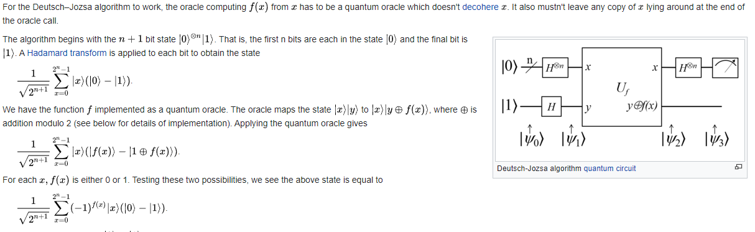
Quantum Mechanical Solution

Slide 10
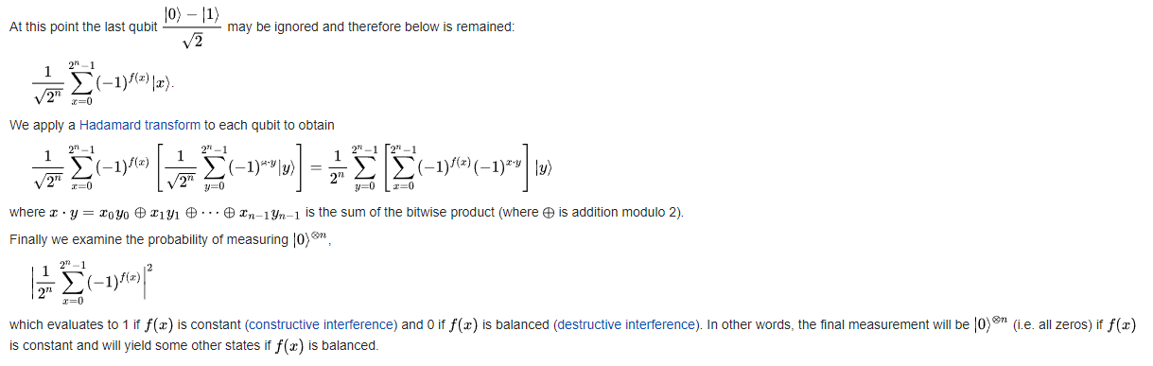
Quantum Mechanical Solution

